Slide 1

Promoting equitable enrollment in clinical trials to improve cardiovascular health in women

Slide 2
AHA President, Bob Harrington, calls for
A Time to Act
”We need to move beyond describing this disparity to increasing female representation in CVD clinical trials so that the evidence for clinical decision-making matches the population with CVD.”
Rodriguez F, Harrington RA. JACC Cardiovasc Int. 2019; 12(3).

Slide 3
Purpose and Goals
Educate principal investigators and site staff about the importance of including women in trials
Understand the main participation barriers for women
Provide practical strategies to promote recruitment and retention of women

Slide 4
Presentation Overview
Understand the current environment
Learn how to overcome the obstacles
1. Current Trends and Disparities
2. Barriers for Women to Enroll in Clinical Trials
3. Tips and Tricks for the Research Team

Slide 5
1. Current Trends and Disparities

Slide 6
A significant burden of cardiac disease in women
Higher cause of death in
women than men

Slide 7

Women in Cardio Campaign Playbook
Many physicians are underinformed of women’s CV disease burden
Notes:
AdvaMed members, in collaboration with a group of leading women cardiologists, have launched a public awareness campaign to encourage recruitment, enrollment and retention of women in cardiovascular device trials.
We created a “campaign playbook” – in other words— a collection of resources, which can be branded, distributed and used by any clinical or health care society or association, patient or consumer group, or company –to raise awareness about the need for more women to enroll in cardiovascular clinical trials.
The materials are free and intended for anyone’s use. All campaign materials are available for download on AdvaMed’s website https://www.advamed.org/advamed-women-cardio-campaign
I’ll run through some of the materials available on these next couple slides.

Slide 8
Women are vastly under-represented in clinical trials
Women represented 30% of patients enrolled in 156 RTCs
Sex-specific results reported in only 31% of primary trial publications
Melloni C, et al. Circ Cardiovasc Qual Outcomes. 2010; 3:135-142.

Slide 9
Why does this matter?
Cardiovascular Disease in Women ≠ Men
A Different Presentation of Disease
Older age of disease onset
More co-morbidities
Different symptom presentation
Higher incidence of non-ischemic HFrEF and HFpEF
Higher HF-related mortality
Anatomic Differences
LV size
QRS duration
A Different Response to Therapy
Aspirin therapy for primary prevention of CV disease has a greater stroke vs MI risk reduction - it’s the opposite for men
Studies suggest that women have greater benefit from CRT
Herz N, et al. Journal of Women’s Health. 2015; 24: 261-71.
Shin J, et al. Heart Failure in Women. Clinical Cardiology. 2012; 35: 172-77.
Hsich E and Pina I, Hear Failure in Women. JACC. 2009; 54: 491-8.
Narashimha D and Curtis A. Arrhythmia and EP Review. 2015; 129-135.
Kim E and Menon V. Arterioscler Thromb Vasc Bio. 2009; 29: 279-283.

Slide 10
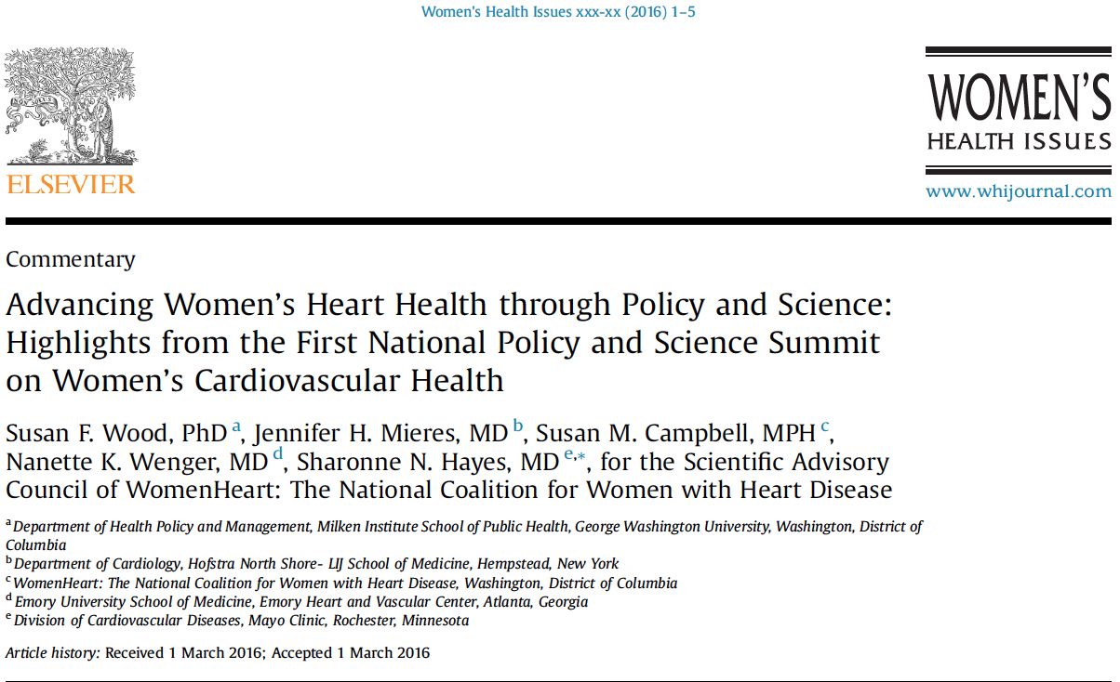
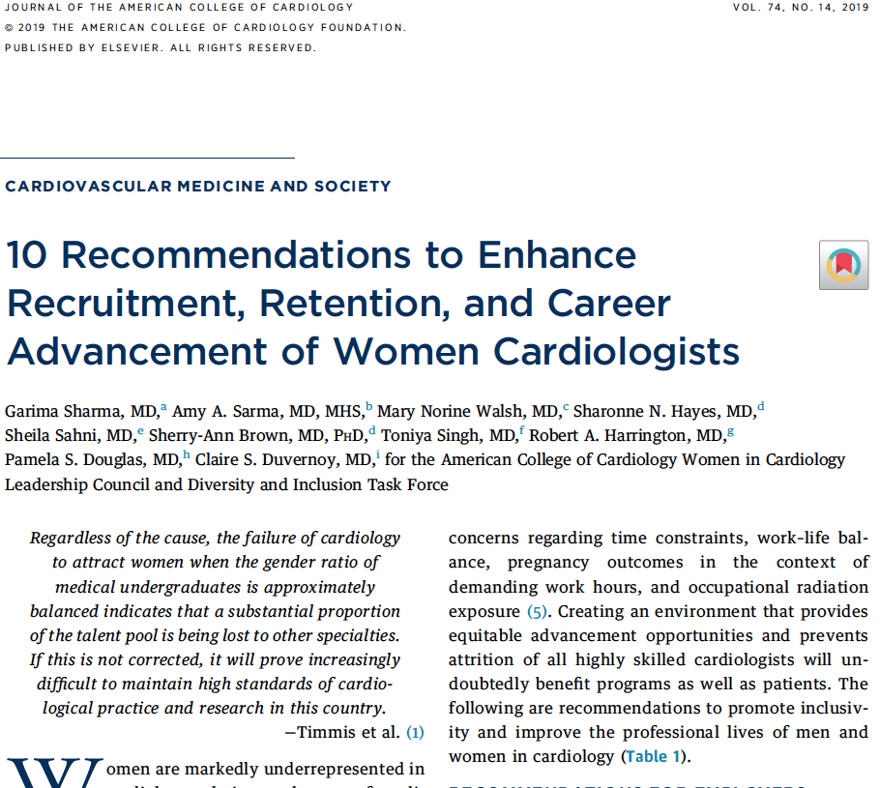
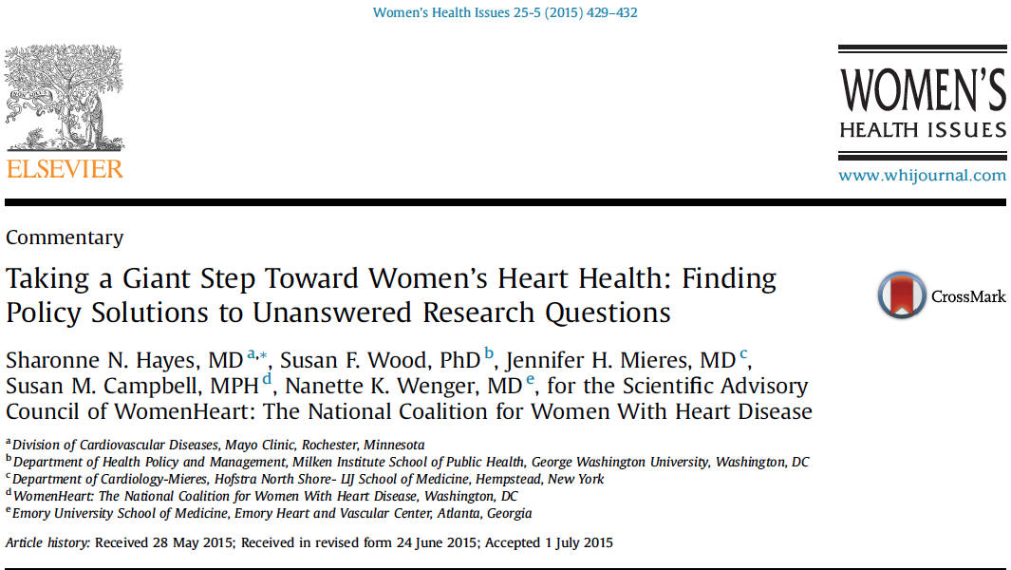
Numerous initiatives already exist

Slide 11
In a review of women enrolled in 78 pre-market approval FDA applications for high-risk CV devices between 2000-2007:
There’s a major lack of sex-specific safety and effectiveness data
No improvement over time in enrollment in CV device trials
Dhruva S, et al. Circ Cardiovasc Qual Outcomes. 2011;4:165-171.
Zusterzeel R, et al. JAMA Internal Medicine. 2014;174(8):1340-48.
Park S, et al. Circ Heart Failure. 2012; 5:241-48.
Holmes D, et al. JACC. 201464:1-12.
Park SJ, et al. NEJM. 2015;372:1204-1212.

Slide 12
2. Barriers for Women to Enroll in Clinical Trials

Slide 13
Both patient and provider factors create barriers along the patient pathway that
drive a lack of participation in CV trials
Physicians ask women less often
Women not referred to specialist / treated in a setting without access to research
Poor physician communication
Patient does not meet criteria or has too many comorbidities
Patient cannot execute participation logistics
Clinical efficiencies create patient burden
Patient initially interested but does not enroll
Patient misunderstands potential risks and benefits
Patient not aware or not asked to participate
Symptoms in women misdiagnosed
Physician Sources
Not aware of opportunities
Limited internet access
Women are older at disease onset
Misunderstand risks and benefits
Lack of educational materials
Cultural biases
Intimidated by terminology
Intimidated by consent form
Financial burden
No time, logistical burden, caregiving responsibilities
Caregiving responsibilities
Extra clinic visits
No time
No transportation
Patient
Sources
Boston Scientific Corporation, WIN-Her Initiative, 2017

Slide 14
Women are more likely to have trust concerns
Fear of experimentation, trust and health-related concerns
Women likely make decisions differently
Need more time and information
Decisions influenced by family/friends
Influenced by altruistic considerations
Sex-based differences in risk tolerance
Under stress, women take fewer risks
Women perceive a greater risk of harm from trial participation
Transportation and convenience issues
Patient Barriers
Women have unique barriers to enrollment
Men are 15-33% more willing to participate
Mather M, Lighthall N. Current Directions in Psychological Science. 2012; 1:36-41.
Benko C, Pelster B. Harvard Business Review. 2013.
Lobato L, et al. BMC Public Health. 2014; 14:1156.
Ding E, et al. Archives of Internal Medicine. 2007;167:905-12 .
Peterson E, et al. American Journal of Geriatric Cardiology. 2004;13:11-15.
GAO16-13 Women in NIH Clinical Trials.

Slide 15
Provider barriers hinder enrollment of women
Awareness
- Referring providers often unfamiliar with current
trials
Subjective Judgments
- Biases to approaching certain patients:
- Older
- Skeptical, emotional
- Unlikely to comply
Competitive Dynamics
- Referring providers fear losing patients to site PIs
Logistical Burden
- Administrative burden is a disincentive to approach
patients who will not easily enroll and comply
Poor Communication
Misdiagnosis
- Women often present with atypical symptoms
- Explanations too brief with too much jargon
Boston Scientific Corporation, WIN-Her Initiative, patient interviews, 2015

Slide 16
3. Tips and tricks for the research team

Slide 17
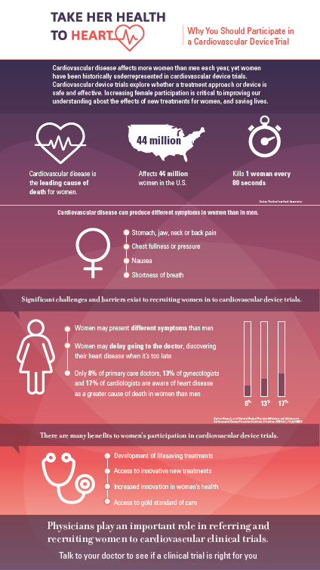
Education
Awareness
Focused Trial Design
Reduce mis-
perceptions about
participation risk
Increase awareness
of cardiac disease in
women and for
participation
opportunities
Examine trial
protocols to increase
the number of
women who qualify

Slide 18
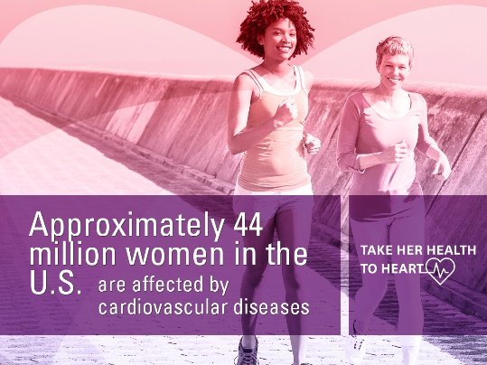
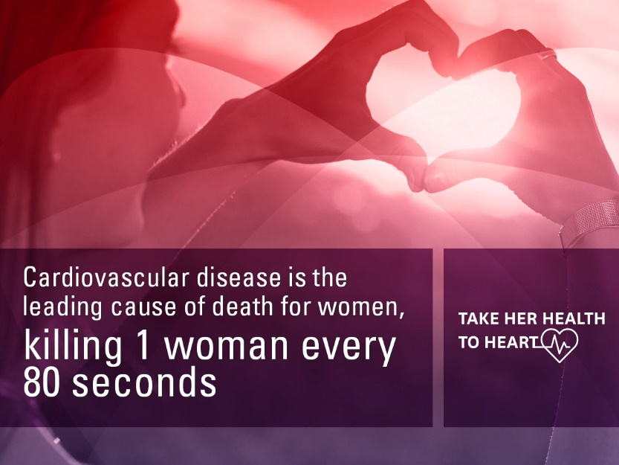
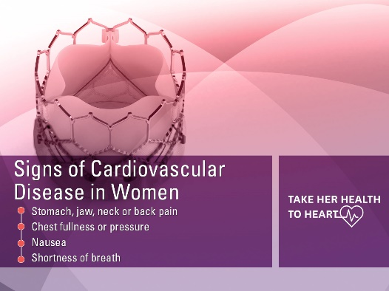
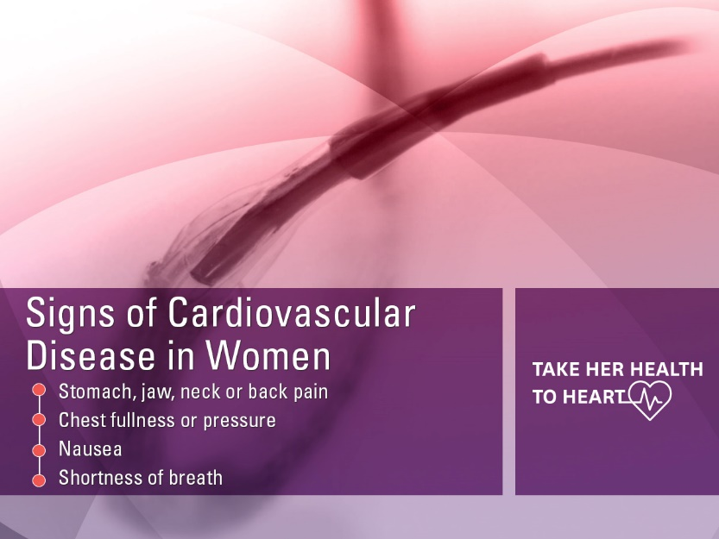
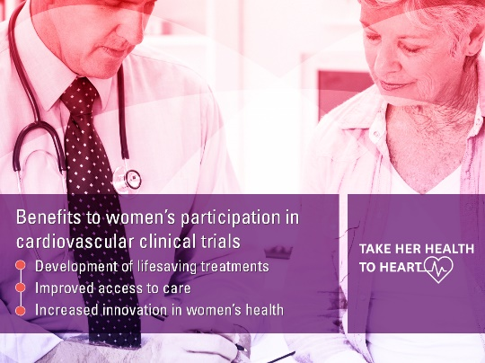
Strategies for Promoting Patient and Provider Awareness
Improve awareness of CV sex- specific symptoms
Targeted Education Campaigns
Leverage Social Media Networks
Introduce patients
and providers to the
impact of sex-
specific symptoms

Slide 19
Issues & Strategies to Enroll Women
Issue: Subjective judgements based
on provider biases
Overcome biases through education and awareness of prejudices
Issue: Referring providers unaware of current trials
Discuss case with academic medical center colleague
Refer to ClinicalTrials.gov for current trials
Refer to cardiology subspecialist
Issue: Administrative
burden of
challenging patients
Educate and discuss compliance with patients
Include grant budget with financial sponsor support for assistance with patient logistics
Feel impowered to reach out to sponsor for additional resources
Issue: Fear of losing
patients to site PI
Have referring provider perform follow-up
Routine communication with referring provider
Consider compensation for additional time spent on patient education, pending IRB approval
Educate referring
providers

Slide 20
Issues & Strategies to Enroll Women
Issue: Fear of experimentation and health concerns
Clear and thorough
explanation
of trial
Benefits of participation
Patient education, reassurance
Explanation that patient’s not a guinea pig: control group is the best standard of care
Issue: Women require more time and more information
Provide adequate time for discussion with the patient
Provide resources for further patient education
Explain details clearly without medical jargon
Issue: Women often rely on family
and friends
Include influential family/friends
at visits
Provide resources for education of family/friends
Introduce
potential benefits
of enrollment
Dispel
misconceptions

Slide 21


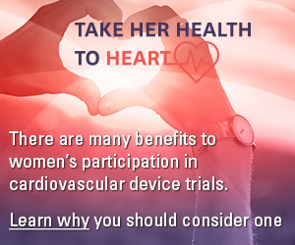
Reduce the misperceptions around participation risk
Description of research process
Benefits of participation
Patient education materials
Leverage social networks to encourage women to participate
Tools to for patients to find research opportunities
Notes:
We also created some digital ads, which can be placed on web pages and linked to the infographic or any webpage with more information about women in cardiovascular trials.

Slide 22
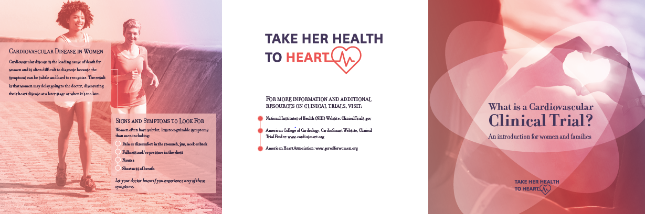
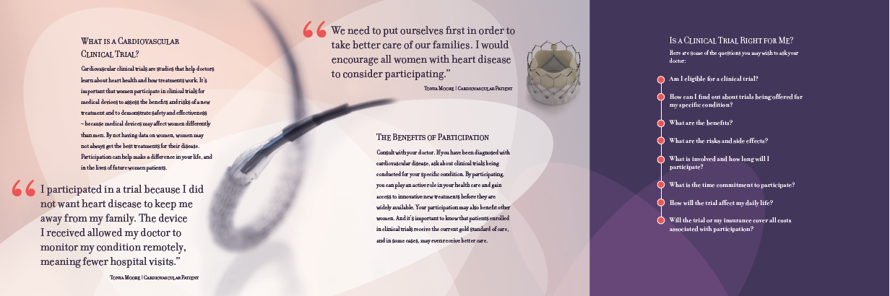
Strategies to Enroll Women
Explain the logistics
upfront
Provide additional reading
and more time for decision-
making

Slide 23






Fewer required follow-up visits
Phone or online follow-up
Home visits
Allowing primary care to complete follow-up
Request transportation reimbursement from
trial sponsor
Weekend hours for required follow-up
Strategies for Retention
Examine trial design
elements and protocols
- Simplify trial burden
- Increase the number
of women who qualify

Slide 24
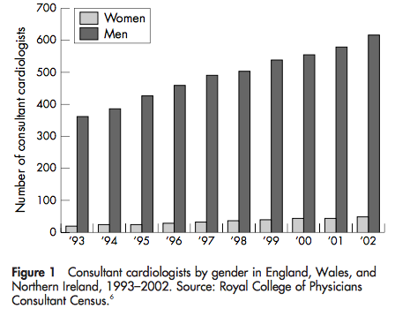
A virtuous cycle – success begets success:
Women Cardiologists Need to Be Engaged
Only 4.5% of interventional cardiologists are women
Women 3x as likely to experience discrimination
There’s a critical need for greater diversity of physician leadership in trials and academia
Wang et al Cath Cardiovasc Interv. 2016
Poppas et al J Am Coll Cardiol. 2008;52:2215–2226

Slide 25
Requires participation from multiple stakeholders: research output is valuable for everyone
Patient education to allay fears of risk
  Patient advocacy
  Public announcements
Clinicians and researcher education and leadership
  Societies
  Journals
  Meetings
  Investigator leadership and funding
Inform guidelines and inclusion in guidelines
  AHA/ACC task force
  ESC task force
Research enrollment targets and sex-based analyses
  FDA
  Industry through AdvaMed
  Journals

Slide 26
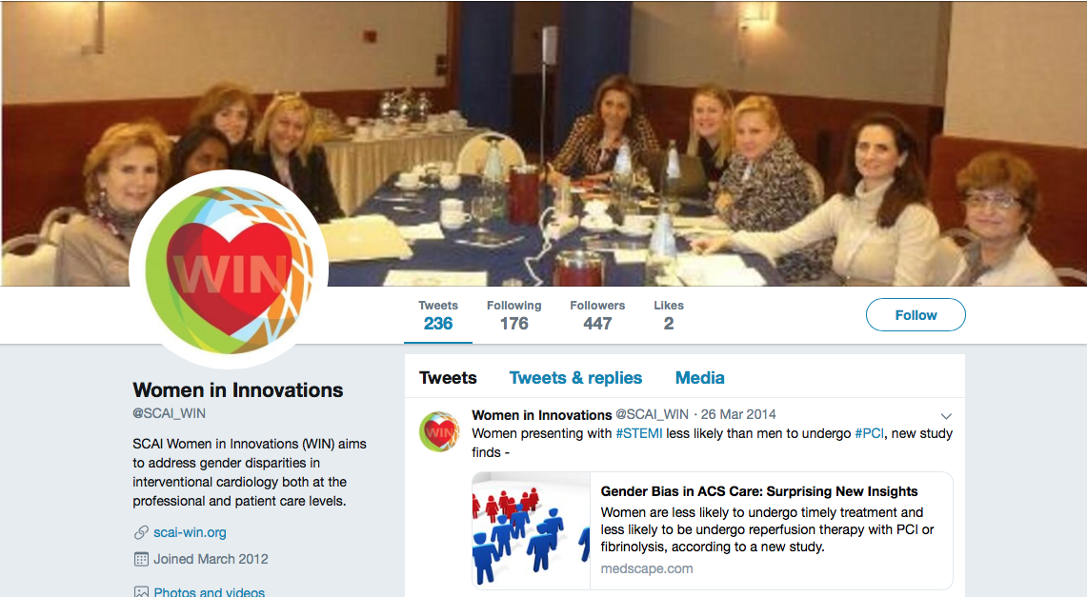
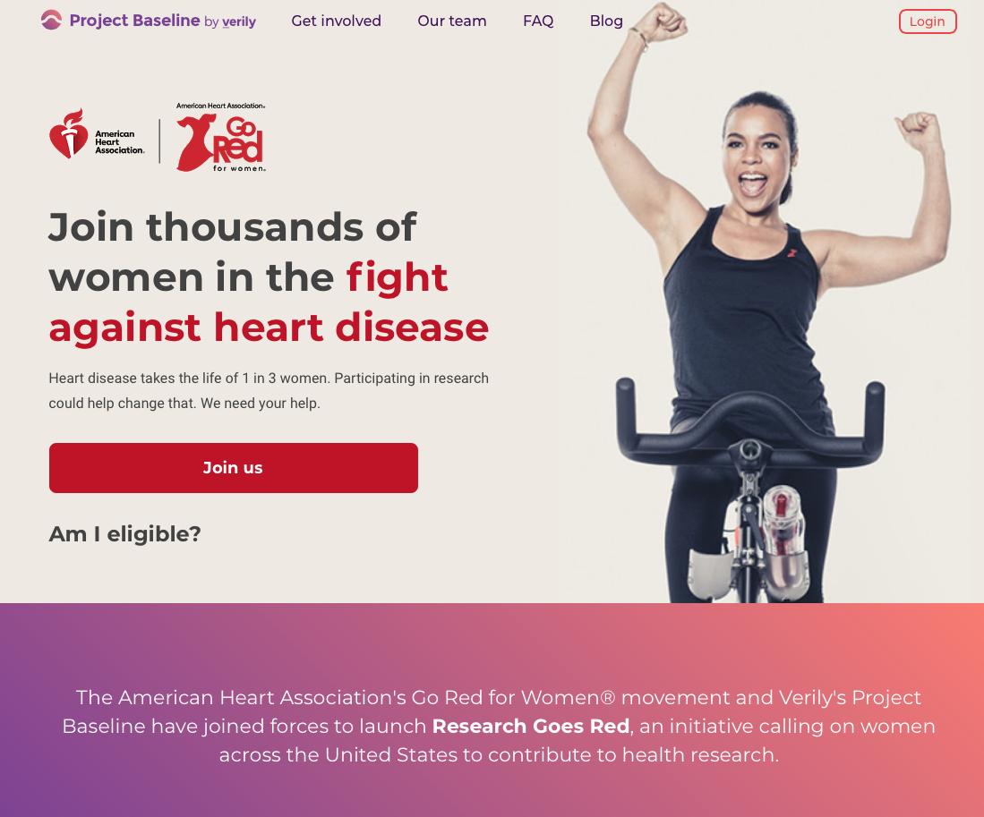
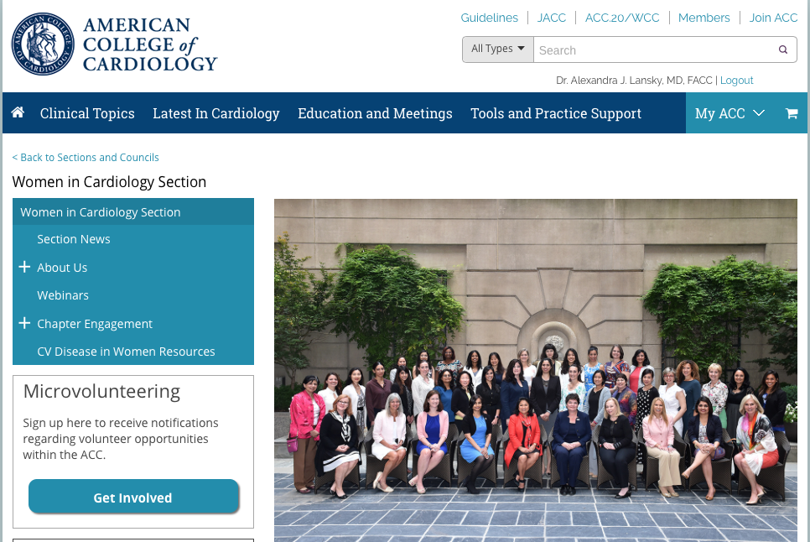
Advocacy groups are here to help
- Endless resources are available for patients and providers

Slide 27
Additional Resources
For additional information please refer to
  ClinicalTrials.gov
  Healthywomen.org

Slide 28
Acknowledgements
Katherine Clark, MD, MBA
Alexandra Lansky, MD, FACC, FAHA, FSCAI, FESC
AdvaMed, and the Take her Health to Heart Collaboration

